Slide 1
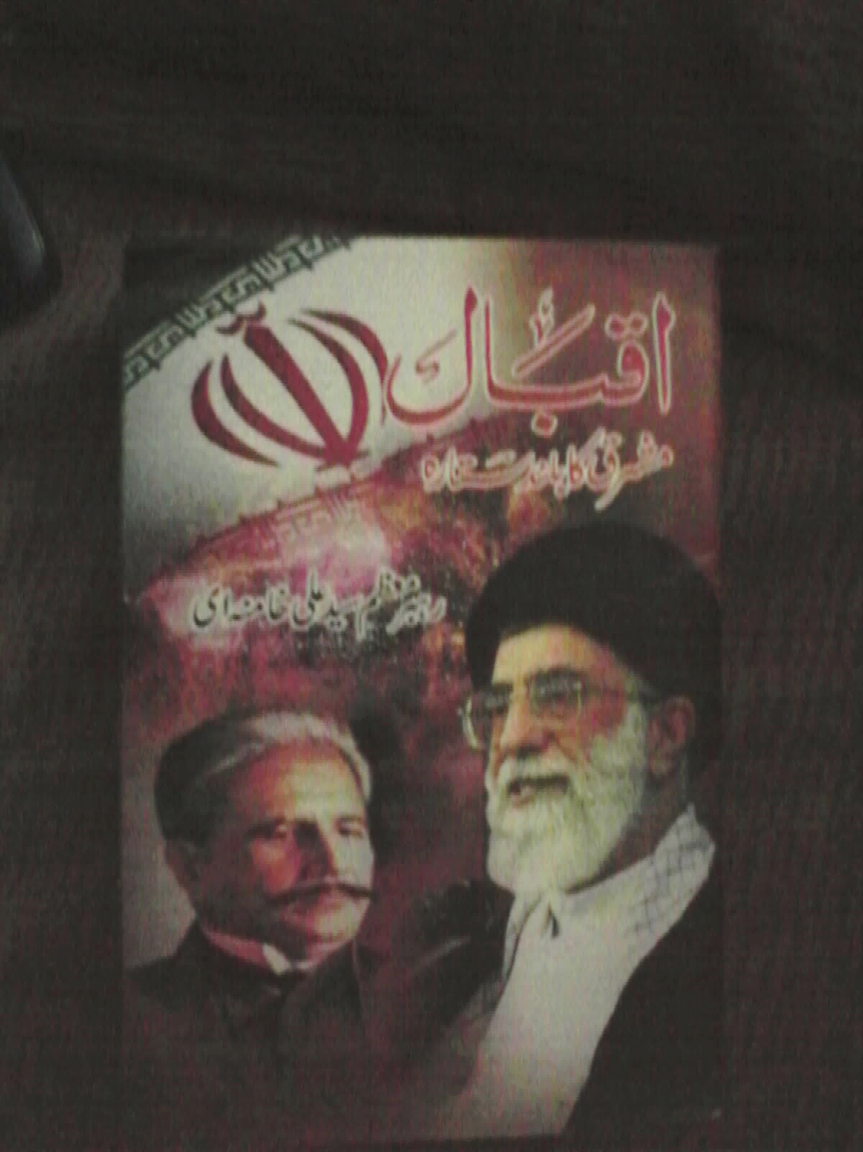
IQBAL
MASHRIQ KA BULAND SITARA
By
REHBAR E MOAZZAM SYED ALI KHAMENEI

Slide 2
Book Information
Book Name: IQBAL MASHRIQ KA BULAND SITARA
Author: Rehbar e Moazzam Syed Ali Khamenei
Compiled and Translated by: Asad Bukhari
Published on: 9th Nov, 2008
Quantity: 1000
Published by: Payam e Noor Publications
Price: Rs: 35/-

Slide 3
Contents
Iqbal aur Iran
Iqbal ke Asha’r
Sub Continent ke Halat
Iqbal ka Kirdar
Iqbal ki Fikr
Conclusion

Slide 4
Iqbal aur Iran
Irani qaum Iqbal se boht dair me agaah hue
Iqbal kabhi Iran nahi gaye
Boht arsey tak Iran me Iqbal ki books aur asha’r ko publish na hone diya
Wo Hindustan se na umeed ho chuke they and un ki nigahen Iran pe thi
Magar aj Iran me Iqbal ki aarzo(na umeedi aur gulami ka khatma) yani Islami hukumat hai
Agar aj zinda hote to boht khush hote

Slide 5
Iqbal ke Asha’r
20th century me Iqbal ne sub continent k logon per buhut gehra asar dala
Iqbal ka Farsi (Persian) kalam bhi kisi mojze se kam na tha (aur inka kisi se muqabla nahi)
Wo Irani culture aur baat cheet se na-waqif the
Urdu ke structure me Iqbal ke asha’r fit nahi hote the
Iqbal ne Farsi deegar shu’raa k kalam se sekhi
Iqbal ka bheterin ta’aruf un ka kalam hai

Slide 6
Sub Continent ke Halat
Iqbal ki paidaish 1877 me hui..yani1857 ki jang e azadi ke 20 saal bad hue
Muslamano ko maali aur saqafati lehaz se buhut dabao’o dala gaya
Hinduon ke zaryie se Muslims ko peche kia gaya
Muslims ko be jurm qatal aur jailon me dala gaya
Aise sakt halat humen tarikh me aj tk nahi milte

Slide 7
Sub Continent ke Halat (Contd…)
Sub continent me 2 tahreeken
Sir Syed
Ullema
Dono tahreeken Muslims ke liye nuqsan dey
Lekin Sir Syed ki tehreek ziada khatarnak thi
Logon(roshan kheyal aur talim yafta) me Islam se doori
Iqbal ka maqam tamam sub continent ke leaders se buland hai
Un ka masla puri Islami duniya aur Mashriq tha

Slide 8
Iqbal ka kirdar
Iqbal apne ustad Sir Thomas Arnold se boht mohabbat krte the
Magar un ki aamaal aur harkaat ko jaante the
Iqbal ka pehla kam Insani shaksiyat ko jagana tha jo so gayi thi
Iqbal ne khudi ki soch di (sare jahan ko)
Khudi = shaksiyat ka ahsas, shaksiyat ka samjhna, khud andeshi etc

Slide 9
Iqbal ka kirdar
Khudi aik inqelabi fikr ki shakal me aya phir unho ne ise falsafiyana rang diya
Khudi aur wujood alag cheez hai (ijtemai)
Khudi duniya ki har cheez me hai… e.g. qatra, zamin, darya, darakht etc

Slide 10
Iqbal ki Aarzoo
Muslims kisi cheez ka dawa nahi krte the
Un me koi bari(big) aarzoo nahi thi
Insan ki aarzoo aur is ki jadd o jehd (khudi)
Muhabbat ke bagar khudi mumkin nahi
Hazart Muhammad (SAW) se muhabat
Ummat e Tauheedi (boht takalif aur experiments ke bad)

Slide 11
Iqbal ki Fiqr
Qaum afrad se nahi balke aik fikr se banti hai
Behtreen fikr Nabuwat hai (jis se Rasool (SAW) ne aik qaum banayi)
Apne ap ko pehchano aur Quran ki baat suno
Ilm magrib se sekha ja skta hai magar tarz e zindagi nahi

Slide 12
CONCLUSION
Qayam e Pakistan Iqbal ka numaya nazarya hai
Iqbal ke kalam ko zaida se zaida parha jaye
Iqbal ke kalam per funkari aur gulukari ki jaye
Iqbal ke kalam (specially Farsi)per aur research ki jaye.
Iqbal ke name se institute kholay jaye and in ke kalam ko samjha jaye

Slide 13
